Slide 1

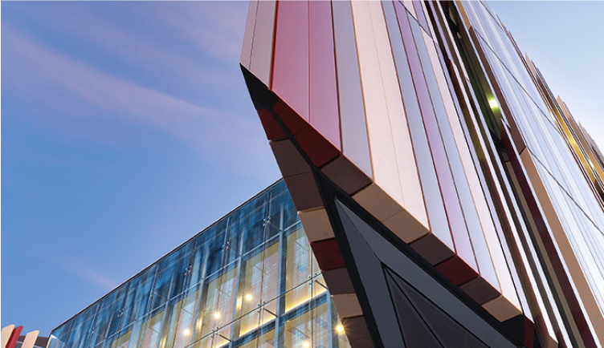
The Master of Ancient History degree
Assoc. Prof. Paul McKechnie

Slide 2
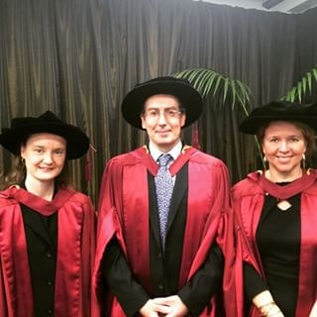
The royal road
[Ask Assoc. Prof. Malcolm Choat, malcolm.choat@mq.edu.au]
BA degree
Best majors: Don’t forget to learn a language:
Ancient History Latin
Classics Greek
History Hieroglyphic Egyptian
Egyptology Coptic
Hebrew
MRes degree
Year 1: Research foundations
Year 2: Substantial thesis
PhD degree
Three years’* pioneering work at the frontiers of knowledge: 80,000-word thesis.
* If all goes well.
Macquarie PhD graduates

Slide 3
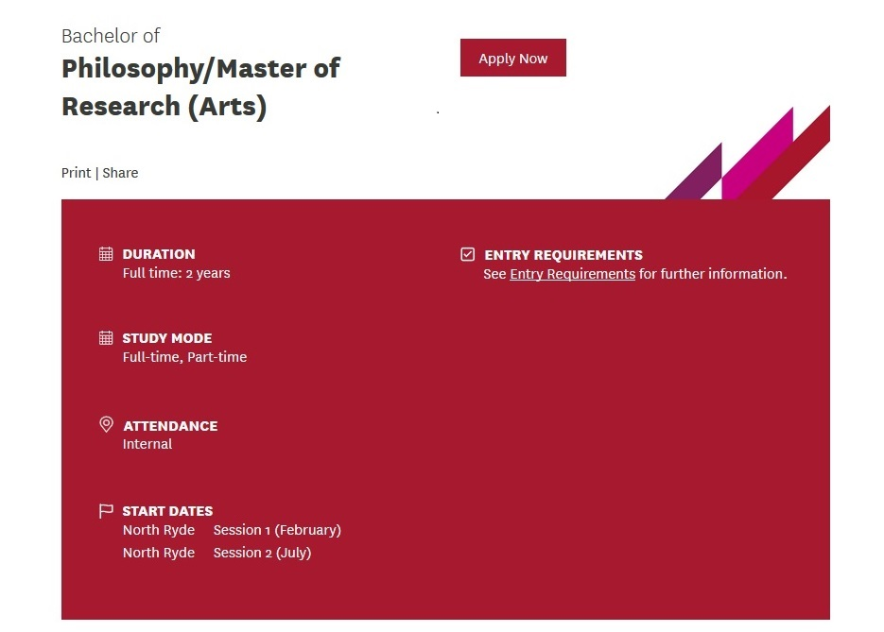
https://courses.mq.edu.au/2018/domestic/research/ bachelor-of-philosophymaster-of-research-arts

Slide 4
This is what you get
Overview
The Bachelor of Philosophy/Master of Research (BPhil/MRes) is a unique combination of advanced coursework and research training:
The first year of the program consists of an advanced undergraduate study program exploration of research frontiers in your discipline.
The second year of the program will be a masters level postgraduate research training program. You'll specialise in research preparation and focus on a specific research topic at the sub-discipline level.
This research training pathway is consistent with the well-known ‘Bologna model’. Students completing this two year program will be well-equipped to complete a PhD in three years, well short of the national average. A completed Master of Research will also be more easily recognised internationally.
The BPhil/MRes replaces most honours as the main pathway to a Doctor of Philosophy (PhD) and Master of Philosophy (MPhil). It is a two-year full-time or equivalent part-time program.

Slide 5

The road to the Master of Ancient History*
Further details from me, paul.mckechnie@mq.edu.au
Any Bachelor degree
Major doesn’t matter
No need to study an ancient language
Include and pass some units which are about the ancient world
You did? You didn’t?
Enrol in Grad. Cert. of Anc. Hist.
Pass four units
Enrol in MAncHist
* There may be ways from this
road back on to the Royal road―
but they will be difficult to find.
Learn an ancient language, then
Consult a wizard.

Slide 6
What (and who) is the degree for?*
‘The protection of wisdom is like the protection of money, and the advantage of knowledge
is that wisdom gives life to the one who possesses it.’ (Ecclesiastes 7.12).
➲ Gaining an ‘advanced and integrated understanding of a
complex body of knowledge in a range of the disciplines
offered: Ancient Greece, Rome, Ancient Egypt, Ancient Israel,
Early Christianity, Coptic Studies’.
Partly for [high-school] teachers of History/Ancient History.
Also for [other] people who want
a postgraduate-standard qualification
in Ancient History.
*Important:
There are no Commonwealth
Supported Places for this degree.
If you are an Australian, this means
the fees will cost more than three times
as much as a degree for which CSPs are
available.

Slide 7
What does one have to do?
A year and a half’s full-time study, or part-time equivalent
● If you’ve got the Grad. Cert., only a year more.
= 48 credit points [12 units, 4 points per unit]:
44 cp from:
AHPG units at 800 or 900 level, or
ECJS units at 800 or 900 level
4 cp from AHPG880 Capstone Advanced Project
The idea is to do
this at or near the end
of one’s studies

Slide 8
A range of units is available
But not all are offered every semester

Slide 9
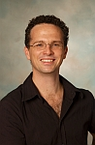
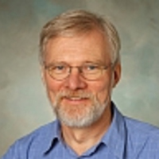
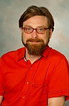
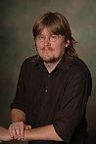
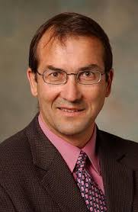
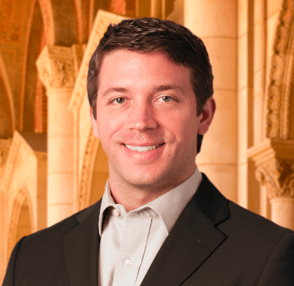
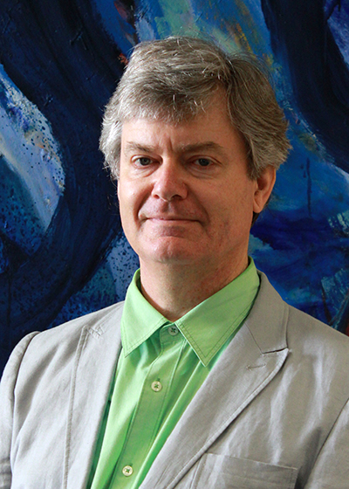
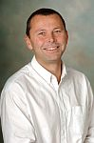
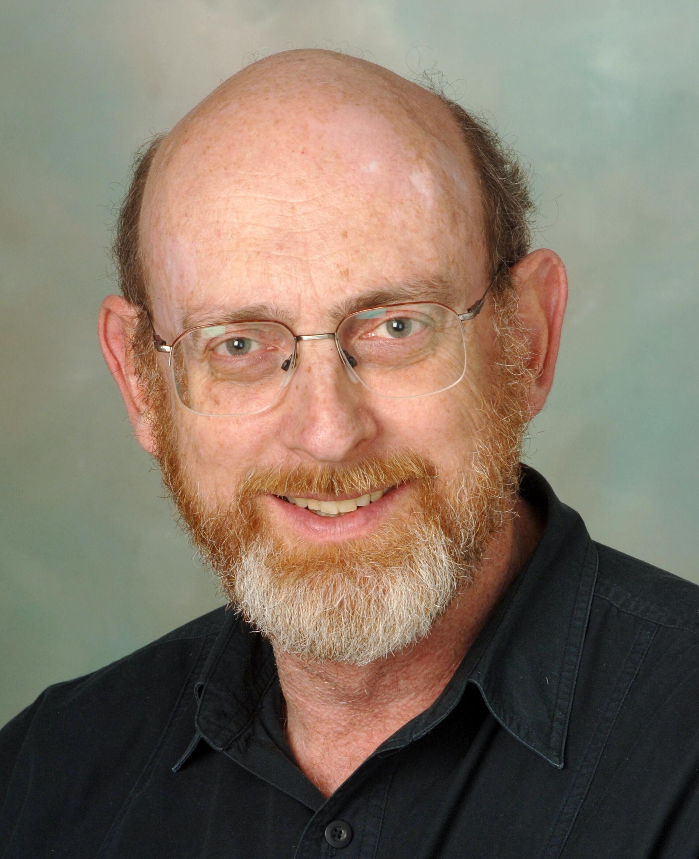
Who’s going to be teaching?
Lecturers 2018
Session 1 |  | Session 2
AHPG875 New Kingdom Egypt | Assoc. Prof. Boyo Ockinga | AHPG824 Caravan Cities | Dr Peter Edwell
AHPG817 Topics in Early Chinese History | Dr. Gunner Mikkelsen | AHPG857 Monasticism in Egypt | Assoc. Prof. Malcolm Choat
AHPG838 Writing Imperial Lives | Assoc. Prof. Peter Keegan | AHPG823 Herodotus and Thucydides | Dr. Ian Plant
ECJS843 The Jews from the Maccabees to Bar Kochba | Dr. Kyle Keimer | AHPG822 Hellenistic Religions | Dr. Chris Forbes
AHPG889 Gregory of Tours | Assoc. Prof. Andrew Gillett | AHPG880 Capstone advanced project | Assoc. Prof. Paul McKechnie
Ockinga
Edwell
Choat
Mikkelsen
Keegan
Keimer
Gillett
Plant
Forbes

